Slide 1
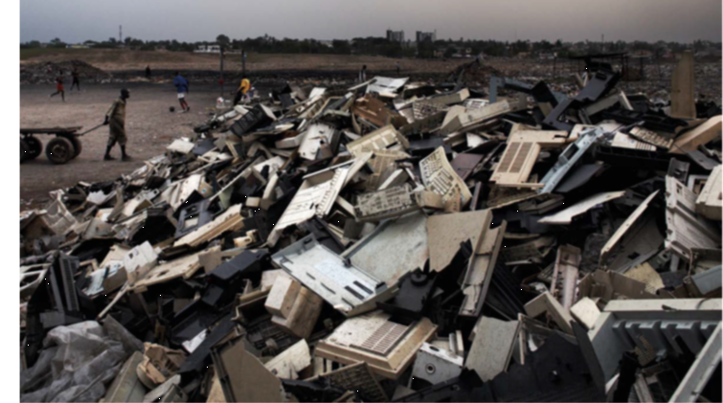
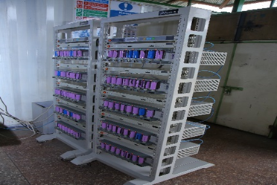
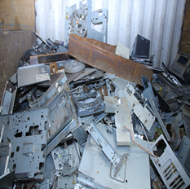
EXPERIENCES IN LEGISLATION STATUS IMPLEMENTATION OF BUNGOMA COUNTY E-WASTE MANAGEMENT BILL-2019 IN KENYA
Anthony Mabele
Member, County Assembly Service Board,
County Assembly of Bungoma,
Bungoma County
E-Waste materials

Slide 2
Presentation outline
E-waste and legislation
Bungoma County e-waste management bill 2019
Current legislation in e-waste management
E-waste management challenges
Perspectives on e-waste management challenges
Core tasks by governments
E-waste flows and framework
Extended Producer Responsibility
Recommendations
Acknowledgements

Slide 3
E-Waste and Legislation
E-waste refers to all items of Electrical and Electronic Equipment (EEE) that have been discarded as waste without the intent of prevention and 4Rs (reduction, reuse, recycling and recovery.
E-waste is also referred to as WEEE (Waste Electrical and Electronic Equipment), electronic waste or e-scrap.
Legislation is the governance process of promulgating/enacting laws.
A bill is an item of legislation in the process of becoming a law.

Slide 4
Bungoma County E-Waste Management Bill-2019 (BCEM Bill 2019)
Developed by the County Assembly of Bungoma e-waste working group.
Through an Act of the County Assembly of Bungoma, Section 2 (g), Part II of the 4th Schedule to the Constitution of Kenya 2010.
To establish the Bungoma County E-Waste Management Committee.

Slide 5
Status of BCEM Bill 2019
Submitted to the Budget and Appropriations committee stage for comments before publication.
BCEM bill-2019 is a money bill as per Article 114 of the Constitution of Kenya 2010, and the County Assembly of Bungoma Standing Orders 111 and 114.

Slide 6
E-Waste Status in Bungoma County and Kenya
Inadequate data on E-waste
Kenya had a total of 57.3 million mobile phone subscribers by June 2020
Internet users were 41.5 million by June 2020
119.9% mobile penetration in the country
Last mile electricity connection programme led to increased use of EEE
COVID - 19 accelerated need for e-transactions

Slide 7
E-waste laws currently in use in Kenya
Constitution of Kenya 2010
Environmental Management and Coordination Act 1999
Waste Management Regulations 2006
Public Procurement and Disposal Act 2015
E-waste guidelines 2011
National E-waste Strategy 2019
Draft E-waste regulations 2022

Slide 8
E-waste management challenges
E-waste dumped everywhere not considering its toxic nature
Huge volumes held by consumers
Obsolete technology e.g. analogue broadcasting gadgets not yet disposed.
Tracing mechanism - very poor
Informal handlers who operate in secretive way
Only 3 licensed e-waste handlers
Inadequate e-waste handling infrastructure

Slide 9
Perspectives on e-waste management challenges
Producers not bound to take responsibility for their obsolete EEE
High learning institutions pay less attention to e-waste management, no curriculum/courses
Extended producer Responsibility (EPR) gap
Lack of EPR responsible for;
Low collection and appropriate disposal of E-waste
Low investment in e-waste processing infrastructure
E-waste dumping everywhere

Slide 10
Core tasks by Governments

Slide 11
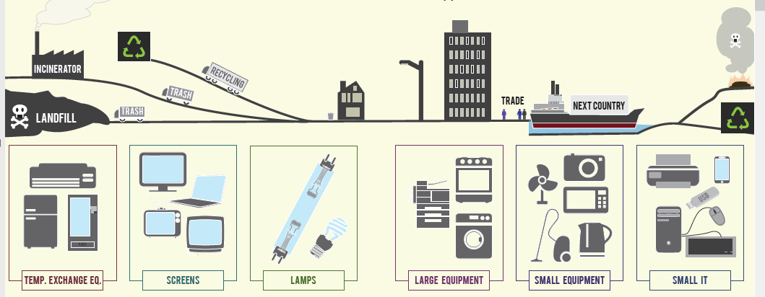
E-waste flows

Slide 12
Framework measuring e-waste flows

Slide 13
Producer Responsibility on E-waste Management
All producers have the following obligations;
All producers to be registered by NEMA
To be members of appropriate Producer Responsibility Organizations (PRO).
All producers to pay fees to PRO for execution of EPR obligations
PRO to execute EPR on behalf of the members
PRO to procure services of E-waste Recyclers, collectors and transporters prior to annual licensing by NEMA.
PRO to submit 2 year EPR plan prior to registration by NEMA.
PRO to declare volumes of E-waste processed annually
PRO to declare funds invested in e-waste management
Both PRO and Producer to be prosecuted in case of breach of EPR obligations

Slide 14
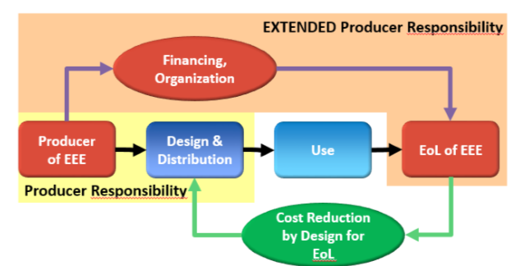
The Basic concept of Extended Producer Responsibility
Source: Baldé, C.P., Wang, F., Kuehr, R., Huisman, J. (2015), The global e-waste monitor – 2014, United Nations University, IAS – SCYCLE, Bonn, Germany.

Slide 15
Recommendations
County Governments to allocate funds and establish e-waste information hubs.
National Government to establish EEE learning institutions and develop curriculum for e-waste management.
Everybody has a role
Everybody assumes his/her responsibility
Operationalize the EPR

Slide 16
Acknowledgements
County Assembly of Bungoma
Bungoma County E-Waste Management Committee
EACO and WG7 for e-waste training/capacity building opportunities.

